Slide 1
Pipe iNSTALLATION
2013 Section Engineer’s Meeting

Slide 2
Before Installation Begins
Correct Type, Gauge, and Coating (Standard Drawings)
Based on Pipe Diameter, Fill Height & Soil pH
Obtain copy of Manufacturer’s Handling and Installation procedures
Pipe Condition
Defects to look for are different for each type of pipe (RCP, CMP, PVC…etc.)

Slide 3
Standard Drawing RDI-035-01

Slide 4
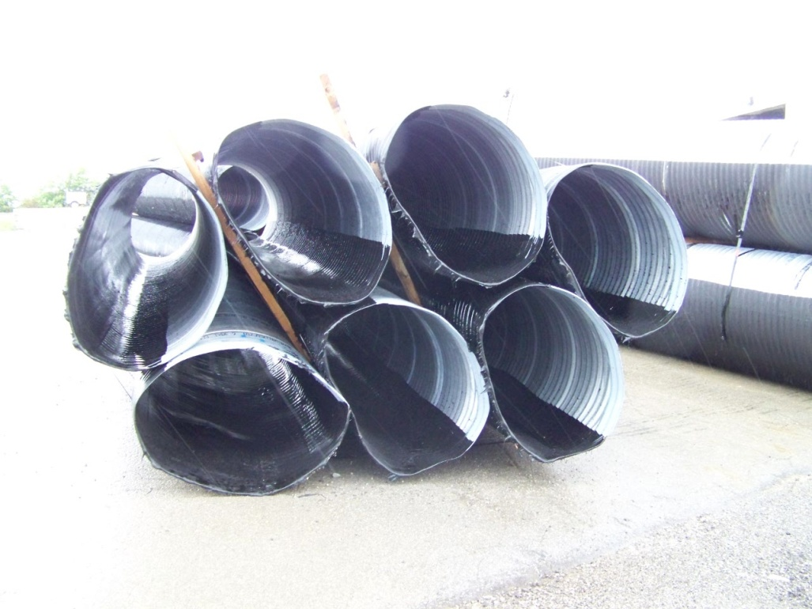
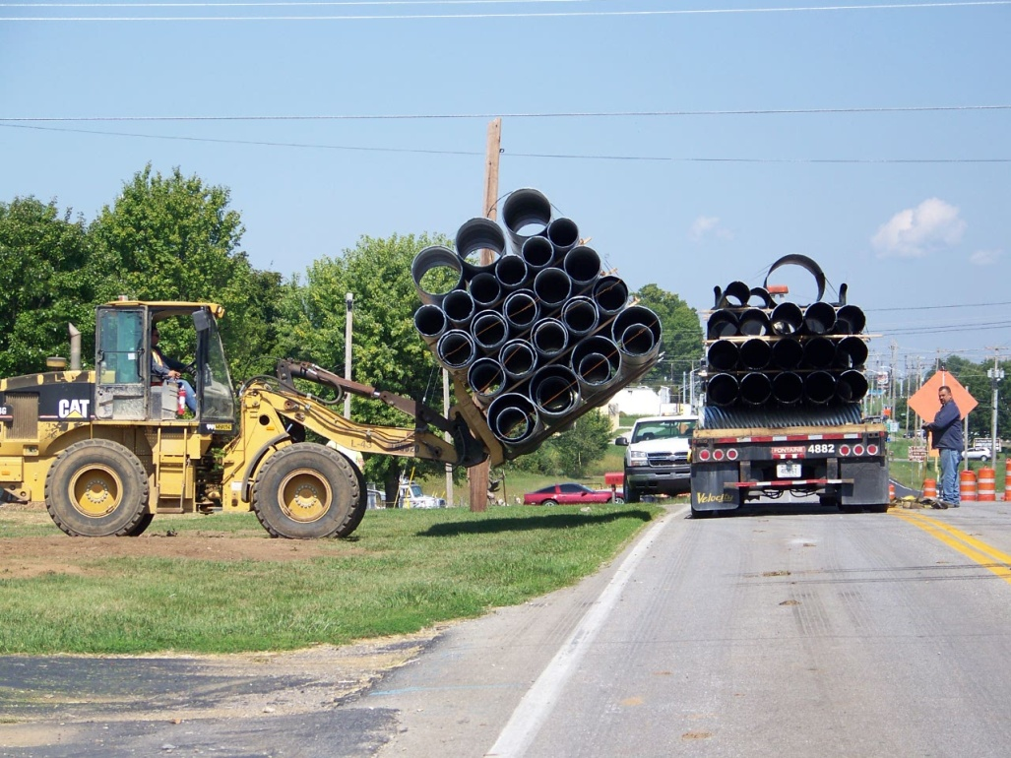
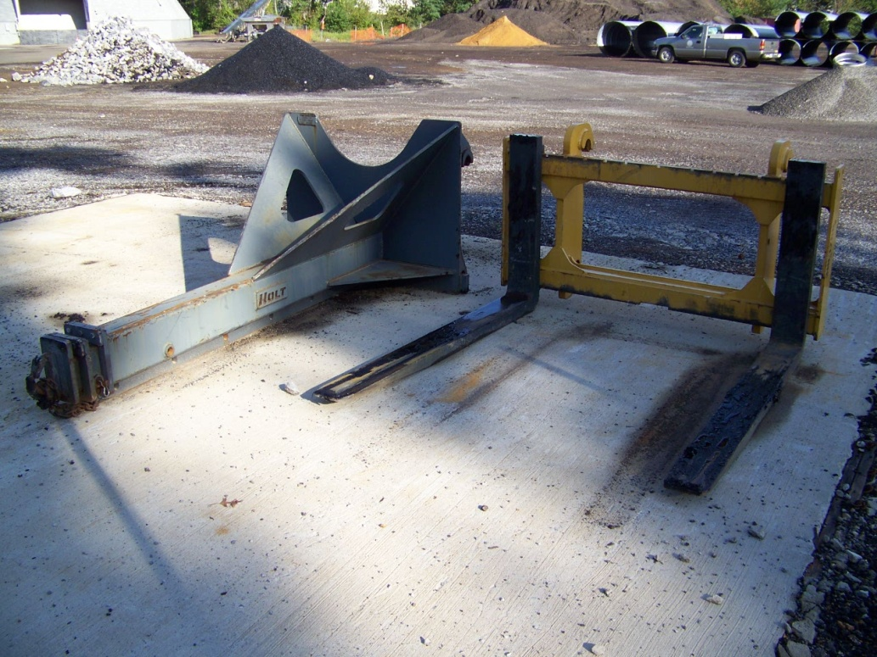
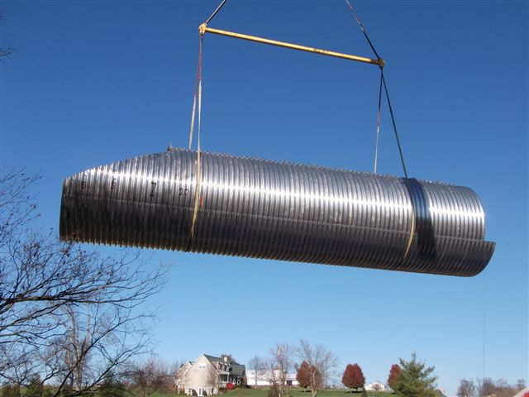

Slide 5
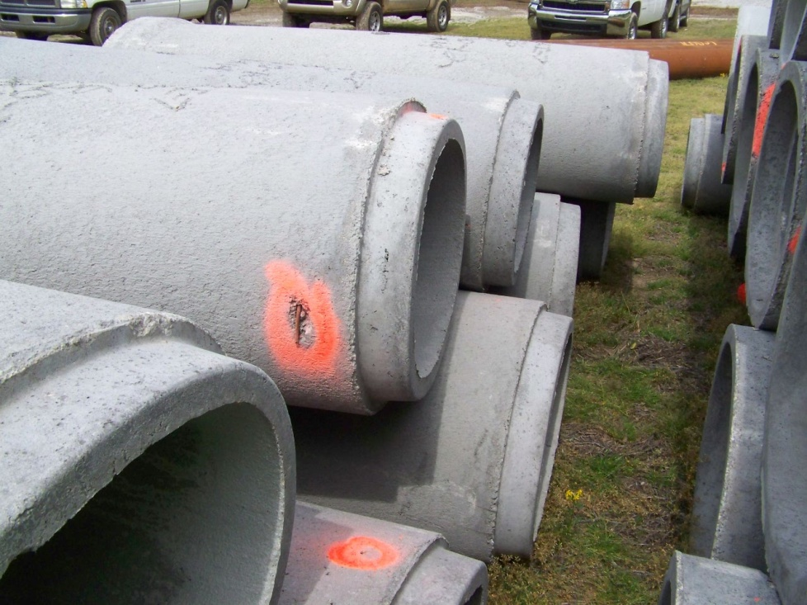
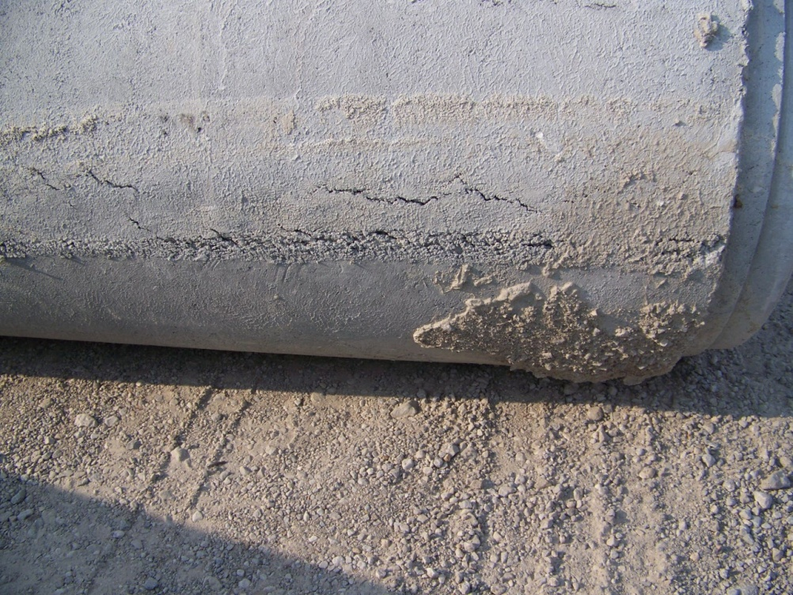
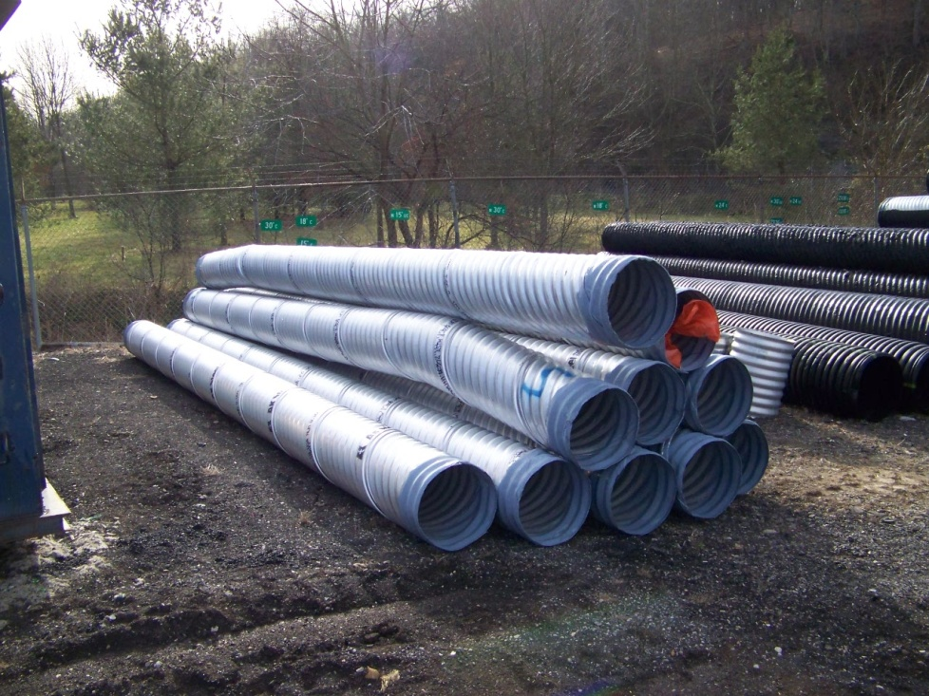
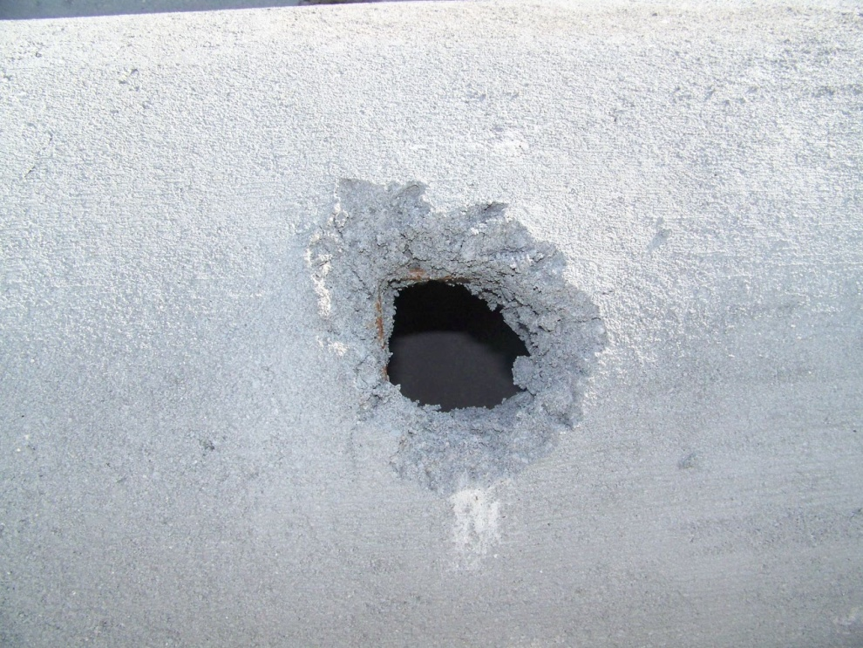

Slide 6
Preparing the Trench
Check Staking
Correct Station
Inlet/Outlet Elevations
Ensure proper grade.
Pipe Pads/Trench Condition
Excavation
Pipe Undercut if Rock or Soft Foundation
Price is in Spec Book

Slide 8
Laying the Pipe
Joints
Construct per Spec depending on Type of Pipe
54” and greater must be wrapped with Type IV Fabric – 3’ min width
Bedding and Fabric
Use No. 8 or 9-M aggregate for bedding
Excavate a cradle for pipe and check with template
Use Type IV Fabric when backfill and surrounding conditions are different gradations, at $2 / sq yd

Slide 9
Backfill
Backfill and Compaction
Granular Backfill in Trench
Flowable Fill –if under existing road or within one pipe diameter of subgrade
Construction Loads – 48 Inches min depth needed
Monitor Pipe During Construction
“Too much emphasis cannot be placed on the necessity of adequate compaction of backfill. Faulty compaction has led to more trouble with pipe installations, flexible and rigid, than all other factors combined!” NCSPA

Slide 10
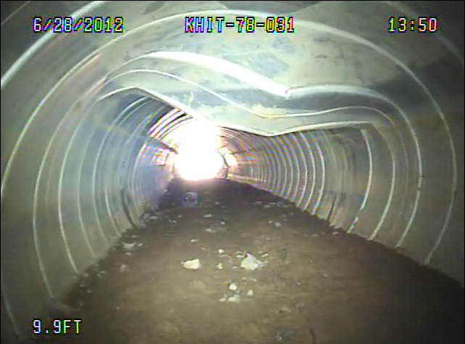
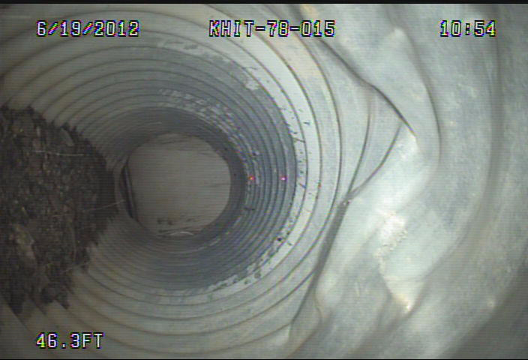
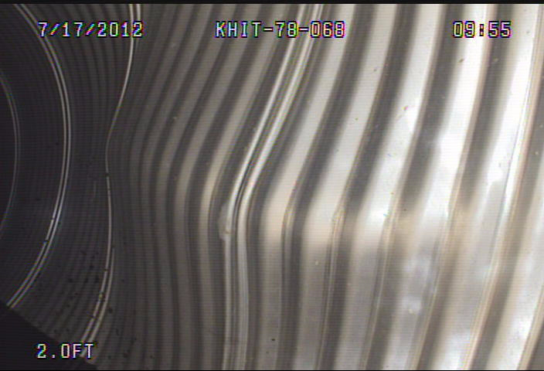

Slide 11
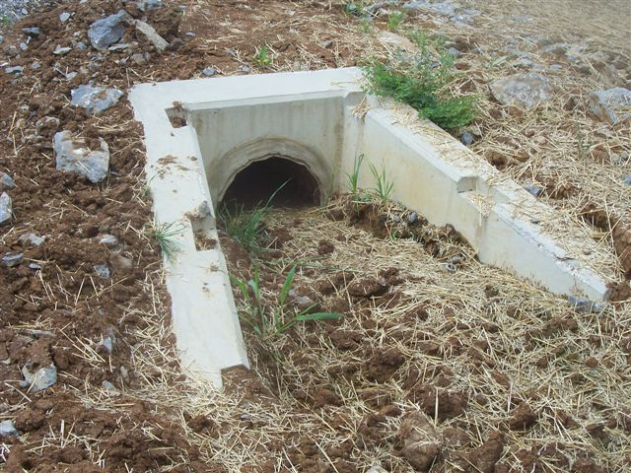
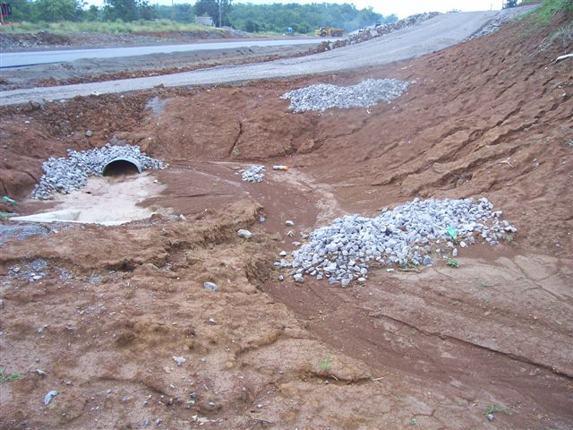
Other Requirments
Safety
OSHA Standards
Proper Erosion Control

Slide 12
2012 NEW SPECS
Pipeline Video Inspection
(> 250 LF of Pipe and ADT > 1,000)
Conduct camera/video inspections in accordance with KM 64-114 on 100 percent of the pipes that are located under the road and 50 percent of the pipes that are not under the road.
Schedule the inspections no sooner than 30 days after completing the installation and completion of earthwork to within 1 foot of the finished subgrade.

Slide 13
Pipe Inspection Results
Crack Testing for Rigid Pipe
< or = 0.1 inch – 100% Pay
> 0.1 inch - Remediate or Replace
Deflection Testing for Flexible Pipe
0.0 to 5% - 100% Pay
5.1 to 7.5% - 75% Pay
7.6 to 9.9% - 50% Pay
10% or greater – Remove and Replace
Note: Structural Analysis to be provided if over 5%

